Slide 1


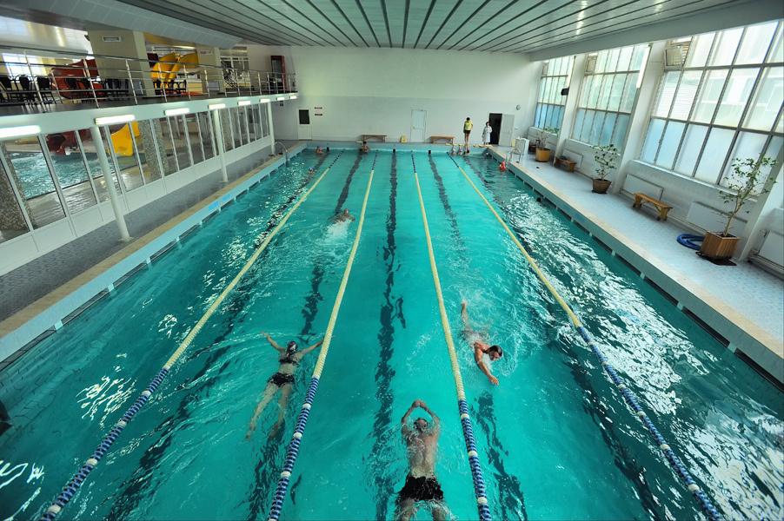

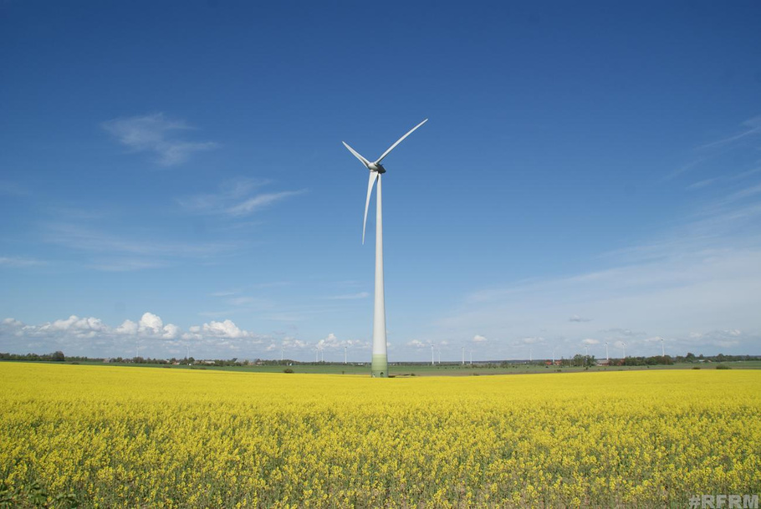



Alternative energy supply for the facilities of Municipal Enterprise "Cherkasyvodokanal"

Slide 2

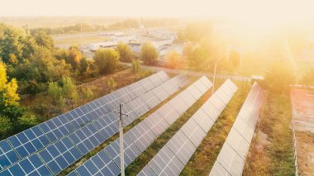



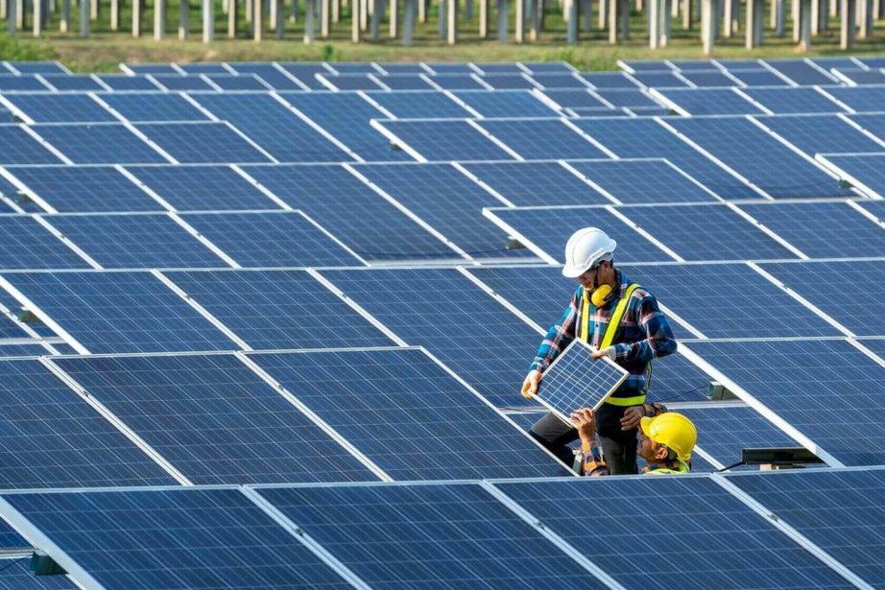



Alternative energy supply for the facilities of Municipal Enterprise "Cherkasyvodokanal"
Construction of a 1MW solar power plant at the Dnipro Water Treatment Plant
The total cost of the project is
≈ 937 000 EUR
Purchase of a modular solar power plant of 300 kW at a pumping station of the III-stage
The total cost of the project is
≈ 562 418 EUR
Purchase of a 1MW modular solar power plant at the reserve water intake "Vilshanka"
The total cost of the project is
≈ 932 398 EUR

Slide 3







Construction of a solar power plant (SPP)
The projects include the
following works:
Social significance of projects:
provision of 24-hour water supply and drainage for the residents of Cherkasy,
in conditions of war and blackouts
reducing the risks of environmental pollution
269 000 residents of the city will receive high-quality centralized water supply services
purchase of equipment
installation of equipment
commissioning of SPP
electric capacity of SPP: 1 MW, 300 kW

Slide 4





Implementation of the project will allow:
to reduce the effects of climate change, to save 3502 trees, 37053 liters of fuel annually
to reduce the level of carbon emissions, to reduce CO2 emissions - 27 tons/year, SOx NOx - 257 kg/year
meet all 100% of the electrical energy needs of Dnipro Water Treatment Plant in the summer months
to supply excess electricity to the power grid of the village of Sokyrno, where 199 residents live

